Slide 1
Year 10: Subject: IGCSE Design & Technology Examination 2015 Gears & Gear Systems
designtechnology
Basic Concepts - 1
Why are we learning about gears and gear systems?
For your Assessed Task you will have to make a computer controlled machine that has movement in it.
That movement will be created by using a small 3-5 volt DC electric motor.
The motor turns at very high speed – about 1200 Revolutions Per Minute (RPM).
Rotary Speed is measured in RPM’s.
The motor turns at very high speed – BUT – it has very little power .
Turning Power is measured in Torque.
You will need to include within your machine a mechanism that can convert the output of the small DC motor into a usable form.
That mechanism is called a gear system.
A gear system can be used to increase or decrease the RPM’s of the motor.
A gear system can be used to increase or decrease the Torque of the motor.
The relationship between RPM’s and Torque is inversely proportional.
In simple terms this means – if you increase one the other reduces.
This chacteristic is perfect situation for our small 3-5 volt DC electric motor.

Slide 2
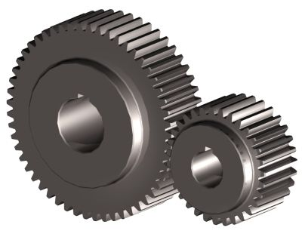
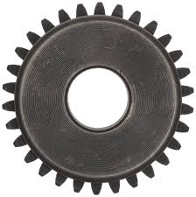
Year 10: Subject: IGCSE Design & Technology Examination 2015 Gears & Gear Systems
designtechnology
Basic Concepts - 2
The most simple type of Gearwheel is a SPUR GEAR.
When you draw a SPUR GEAR you must use the internationally agreed drawing conventions.
This is a picture of a spur gear.
This is a drawing of the same spur gear using a drawing convention.
These are
called Gear Teeth.
This dot represents
The centre of the Gearwheel.
These two circles represent the tops and bottoms of the Gearwheel TEETH.
Gearwheels work by the teeth interlocking together.
The zone where the teeth interlock is called MESH.

Slide 3
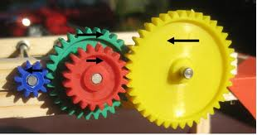
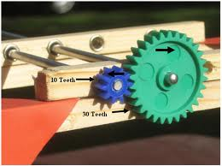
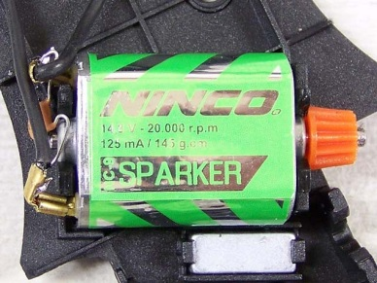
Year 10: Subject: IGCSE Design & Technology Examination 2015 Gears & Gear Systems
designtechnology
Basic Concepts - 3
When gearwheels are interlocked together the resulting assembly is called a GEAR TRAIN.
If there are just two gear- wheels in the assembly it is called a SIMPLE GEAR TRAIN.
If there are three or more gear- wheels in the assembly it is called a COMPOUND GEAR TRAIN.
The gearwheel
that is connected onto the motor drive shaft
is called the
DRIVER GEAR.
In a SIMPLE GEAR TRAIN the gearwheel that is turned by the DRIVER GEAR
is called the
DRIVEN GEAR.

Slide 4
Year 10: Subject: IGCSE Design & Technology Examination 2015 Gears & Gear Systems
designtechnology
Basic Concepts - 4
The gearwheels in a COMPOUND GEAR TRAIN have got special names.
The Gearwheel that is fitted to the motor drive shaft is still called the DRIVER GEAR.
The final Gearwheel that is connected to the
OUTPUT SHAFT is called
the DRIVEN GEAR.
Any Gearwheels that are between the DRIVER & the DRIVEN are called
IDLER GEARS.
Any GEAR SHAFTS that carry the IDLER GEARS are called IDLER SHAFTS.
The IDLER GEARWHEELS all turn together. They are all locked onto the IDLER SHAFT.
The DRIVER GEARWHEEL is only fixed/locked to the DRIVE/INPUT SHAFT.
The DRIVEN GEARWHEEL is only fixed/locked to the OUTPUT SHAFT.

Slide 5
Year 10: Subject: IGCSE Design & Technology Examination 2015 Gears & Gear Systems
designtechnology
Basic Concepts - 5
When the DRIVER GEAR is
SMALLER
than the
DRIVEN GEAR.
The gear train will REDUCE RPM’s.
When the DRIVER GEAR is
LARGER
than the
DRIVEN GEAR.
The gear train will INCREASE RPM’s.
Small DRIVER GEAR.
Large DRIVEN GEAR.
Large DRIVER GEAR.
Small DRIVEN GEAR.
= REDUCED RPM’s
= INCREASED RPM’s
Gear System Calculations
You will need to demonstrate that you can do basic gear system calculations.
You will need to demonstrate that you can calculate GEAR RATIO and INPUT/OUTPUT RPM’s and the various sizes of gearwheels to put into a gear system.
The calculations are straight forward and just require a simple understanding of algebra and some common sense!
If the Driver gearwheel turns one revolution how much does the driven gearwheel turn?
Getting Started
If the Driver gearwheel turns at 600 rpm’s how fast does the driven gearwheel turn?
DRIVER GEAR has 10 teeth.
DRIVEN GEAR has 20 teeth.

Slide 6
Year 10: Subject: IGCSE Design & Technology Examination 2015 Gears & Gear Systems
designtechnology
Basic Concepts – 6 Gear System Calculations (Simple Gear Trains)
GEAR RATIO.
Is all about how many revolutions the DRIVER gearwheel turns compared to the DRIVEN.
You write GEAR RATIOS like this example 1 : 2 or 2:1
The DRIVER Gear is written first and the DRIVEN written second.
This is the formula to calculate GEAR RATIO in a SIMPLE GEAR TRAIN.
The number of teeth on the DRIVER = Gear Ratio
The number of teeth on the DRIVEN.
Calculate the GEAR RATIO for these three examples.
Example 1.
Example 2.
DRIVER GEAR has 10 teeth.
DRIVEN GEAR has 20 teeth.
DRIVER GEAR has 8 teeth.
DRIVEN GEAR has 60 teeth.
Example 3.
DRIVEN GEAR has 20 teeth.
DRIVER GEAR has 160 teeth.

Slide 7
Year 10: Subject: IGCSE Design & Technology Examination 2015 Gears & Gear Systems
designtechnology
Basic Concepts – 7 Gear System Calculations (Simple Gear Trains)
RPM Calculations.
Is all about how many revolutions the DRIVER gearwheel turns compared to the DRIVEN.
INPUT rpm’s refer to the turning speed of the DRIVER Gear
OUTPUT rpm’s refer to the DRIVEN Gear
This is the formula to calculate RPM’s.
The number of teeth on the DRIVER x INPUT RPM = OUTPUT RPM
The number of teeth on the DRIVEN.
Calculate the OUTPUT RPM’s for these three examples.
Example 2.
Example 1.
DRIVER GEAR has 8 teeth and is turning at 1200 rpm.
DRIVEN GEAR has 60 teeth.
DRIVER GEAR has 10 teeth and is turning at 1000 rpm.
DRIVEN GEAR has 20 teeth.
Example 3.
DRIVEN GEAR has 20 teeth.
DRIVER GEAR has 160 teeth and is turning at 1500 rpm.

Slide 8
Year 10: Subject: IGCSE Design & Technology Examination 2015 Gears & Gear Systems
designtechnology
Basic Concepts – 8 Gear System Calculations (Compound Gear Trains)
This is not as difficult as you might first think .
The easiest way to do this is to calculate the INPUT/OUTPUT RPM’s and then use this information to
work out the INPUT/OUTPUT RATIO based upon the relationship between the two rpm figures.
Think of a Compound Gear Train as a group of interlocking Simple Gear Trains.
Group One.
Group Two.
Group Two.
Group One.
1500
RPM
120
teeth
10
teeth
40
teeth
80
teeth
To calculate the GEAR RATIO or OUTPUT RPM of a COMPOUND GEAR TRAIN you need to know the following information:
The number of teeth on each of the gearwheels
and the INPUT RPM.

Slide 9
Year 10: Subject: IGCSE Design & Technology Examination 2015 Gears & Gear Systems
designtechnology
Basic Concepts – 9 Gear System Calculations (Compound Gear Trains)
Think of a Compound Gear Train as a group of interlocking Simple Gear Trains.
Deal with Group One first and just concentrate on the RPM’s
The number of teeth on the DRIVER x INPUT RPM = OUTPUT RPM
The number of teeth on the DRIVEN.
Group Two.
10 x 1500 = OUTPUT RPM (IDLER SHAFT)
40
Group One.
1 x 1500 = 375 RPM (IDLER SHAFT)
4
1500
RPM
120
teeth
10
teeth
40
teeth
Deal with Group Two next and just concentrate on the RPM’s
80
teeth
The number of teeth on the DRIVER x INPUT RPM = OUTPUT RPM
The number of teeth on the DRIVEN.
80 x 375 (IDLER SHAFT) = OUTPUT RPM
120
2 x 375 (IDLER SHAFT) = 250 OUTPUT / Shaft RPM
3
RPM on the DRIVER = Gear Ratio
RPM on the DRIVEN.
1500 = Gear Ratio
250.
6 : 1 = Gear Ratio

Slide 10
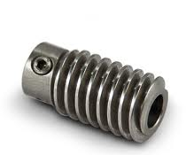
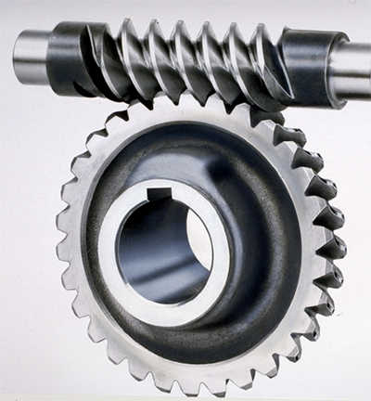
Year 10: Subject: IGCSE Design & Technology Examination 2015 Gears & Gear Systems
designtechnology
Basic Concepts – 10 Special Gears
You need to know about other types of gearwheel.
Worm Gear.
The Worm Gear is the most common gear used in all
compound gear trains where large RPM reductions and significant increases in torque are required.
It has a unique feature that enables it to make an instant and massive reduction in RPM’s.
It only has one spiral tooth.
BUT it can only be used as a DRIVER GEAR.
The WORM GEAR is usually called the WORM.
The GEAR Wheel it drives is called the WORM WHEEL.
The Graphic Symbols for a Worm & Worm Wheel.
The Worm - end view
Worm Wheel – end view
The Worm - side view
Worm Wheel – side view

Slide 11
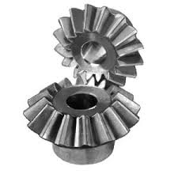
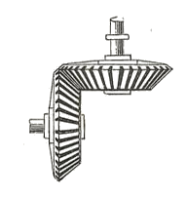
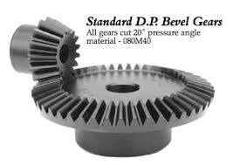
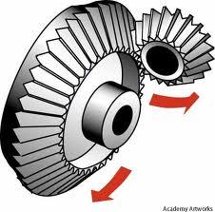
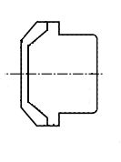
Year 10: Subject: IGCSE Design & Technology Examination 2015 Gears & Gear Systems
designtechnology
Basic Concepts – 11 More Special Gears
Mitre Gears.
These are gears that are used to turn the direction of the drive through 90⁰.
They are usually the same size and are mounted at right angles to each other. Because they are the same size they are not used to reduce or increase rpm. Their function is usually just to turn the drive through 90⁰.
If you want to turn the drive through 90⁰ and alter the RPM’s at the same time you will need to use a different type of gear wheel.
Bevel Gears.
Bevel Gears are very specialised gears and are made specifically to have teeth that mesh correctly.
Symbol for a Mitre or Bevel Gear.

Slide 12
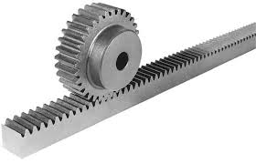
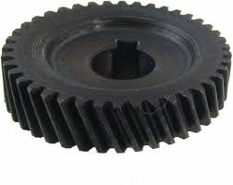
Year 10: Subject: IGCSE Design & Technology Examination 2015 Gears & Gear Systems
designtechnology
Basic Concepts – 11 More Special Gears
Rack & Pinion.
A Rack and Pinion Gear is another specialised gear which has very specific applications. It is used in situations where you want to convert rotary motion into linear motion or visa-versa.
Symbol for a
Rack & Pinion.
Pinion.
Rack
Gear Chatter
Spur gears and any gears where the teeth are parallel to each other create a lot of noise. This noise is called chatter. Each of the gears in the gear train vibrate from side to side as they turn and it is the noise created by the vibrations that is called chatter. This noise can be stopped by using gear wheels with curved teeth.
Helix gears
Have been developed to reduce and eliminate noise from gear trains.

Slide 13
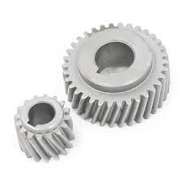
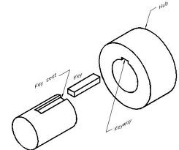
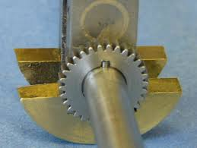
Year 10: Subject: IGCSE Design & Technology Examination 2015 Gears & Gear Systems
designtechnology
Basic Concepts – 12 How do Gear Wheels Lock onto the Gear or Drive Shaft?
The gear wheel needs to be fixed firmly onto the shaft in such a way that it will not slip. If any slipping does happen output drive and power from the Gear train will be reduced or stop.
The solution to this problem is simple.
A rectangular slot is accurately cut into the hole in the gear wheel
A matching slot is accurately cut into the shaft.
When the two are assembled the slots are aligned and extra piece of metal called a key is inserted into the slots.
When all three parts are assembled the transmission of power between the gearwheel and the shaft is absolute.

